Slide 1
Related arts
PE
Music
Visual Art

Slide 2
Goals & Expectations
Students are expected to
participate
put forth their best effort
The goal is always improvement,
never perfection.

Slide 3
Arts & wellness education is more important now than ever before.
Establishing foundational knowledge
Fostering creative expression
Connecting with emotions
Coping with uncertainty
Meet your teachers….

Slide 4
Ms. K. Norman
Visual Art Specialist
Karen.norman@slps.org

Slide 5
Greetings!!
I am the Visual Art teacher at Mason. I have been teaching at Mason for 23 years. I am married and I have three grown children. I have one grandson. I love to go to museums, travel, and garden. I completed my B.A. from Webster University in 1980. I studied photography, media, and art. I also received my teaching certificate for Art K-12. I began my teaching career in 1998. I have completed two Master's degrees, one in Education and the other in TESOL. I love to learn about world cultures and art. But mostly I love to share art with all the students at Mason!

Slide 6
Visual Arts Expectations
Students will be respectful towards other students, the art materials, and the Art teacher.
Students will complete all art projects to their best ability.
Students will create artworks that include the elements and principles of design.
Students will express ideas through original artworks, using a variety of media with appropriate skills.
Students will demonstrate an understanding of art history and culture as records of history.
Students will make informed judgments about personal artwork and the artwork of others.

Slide 7
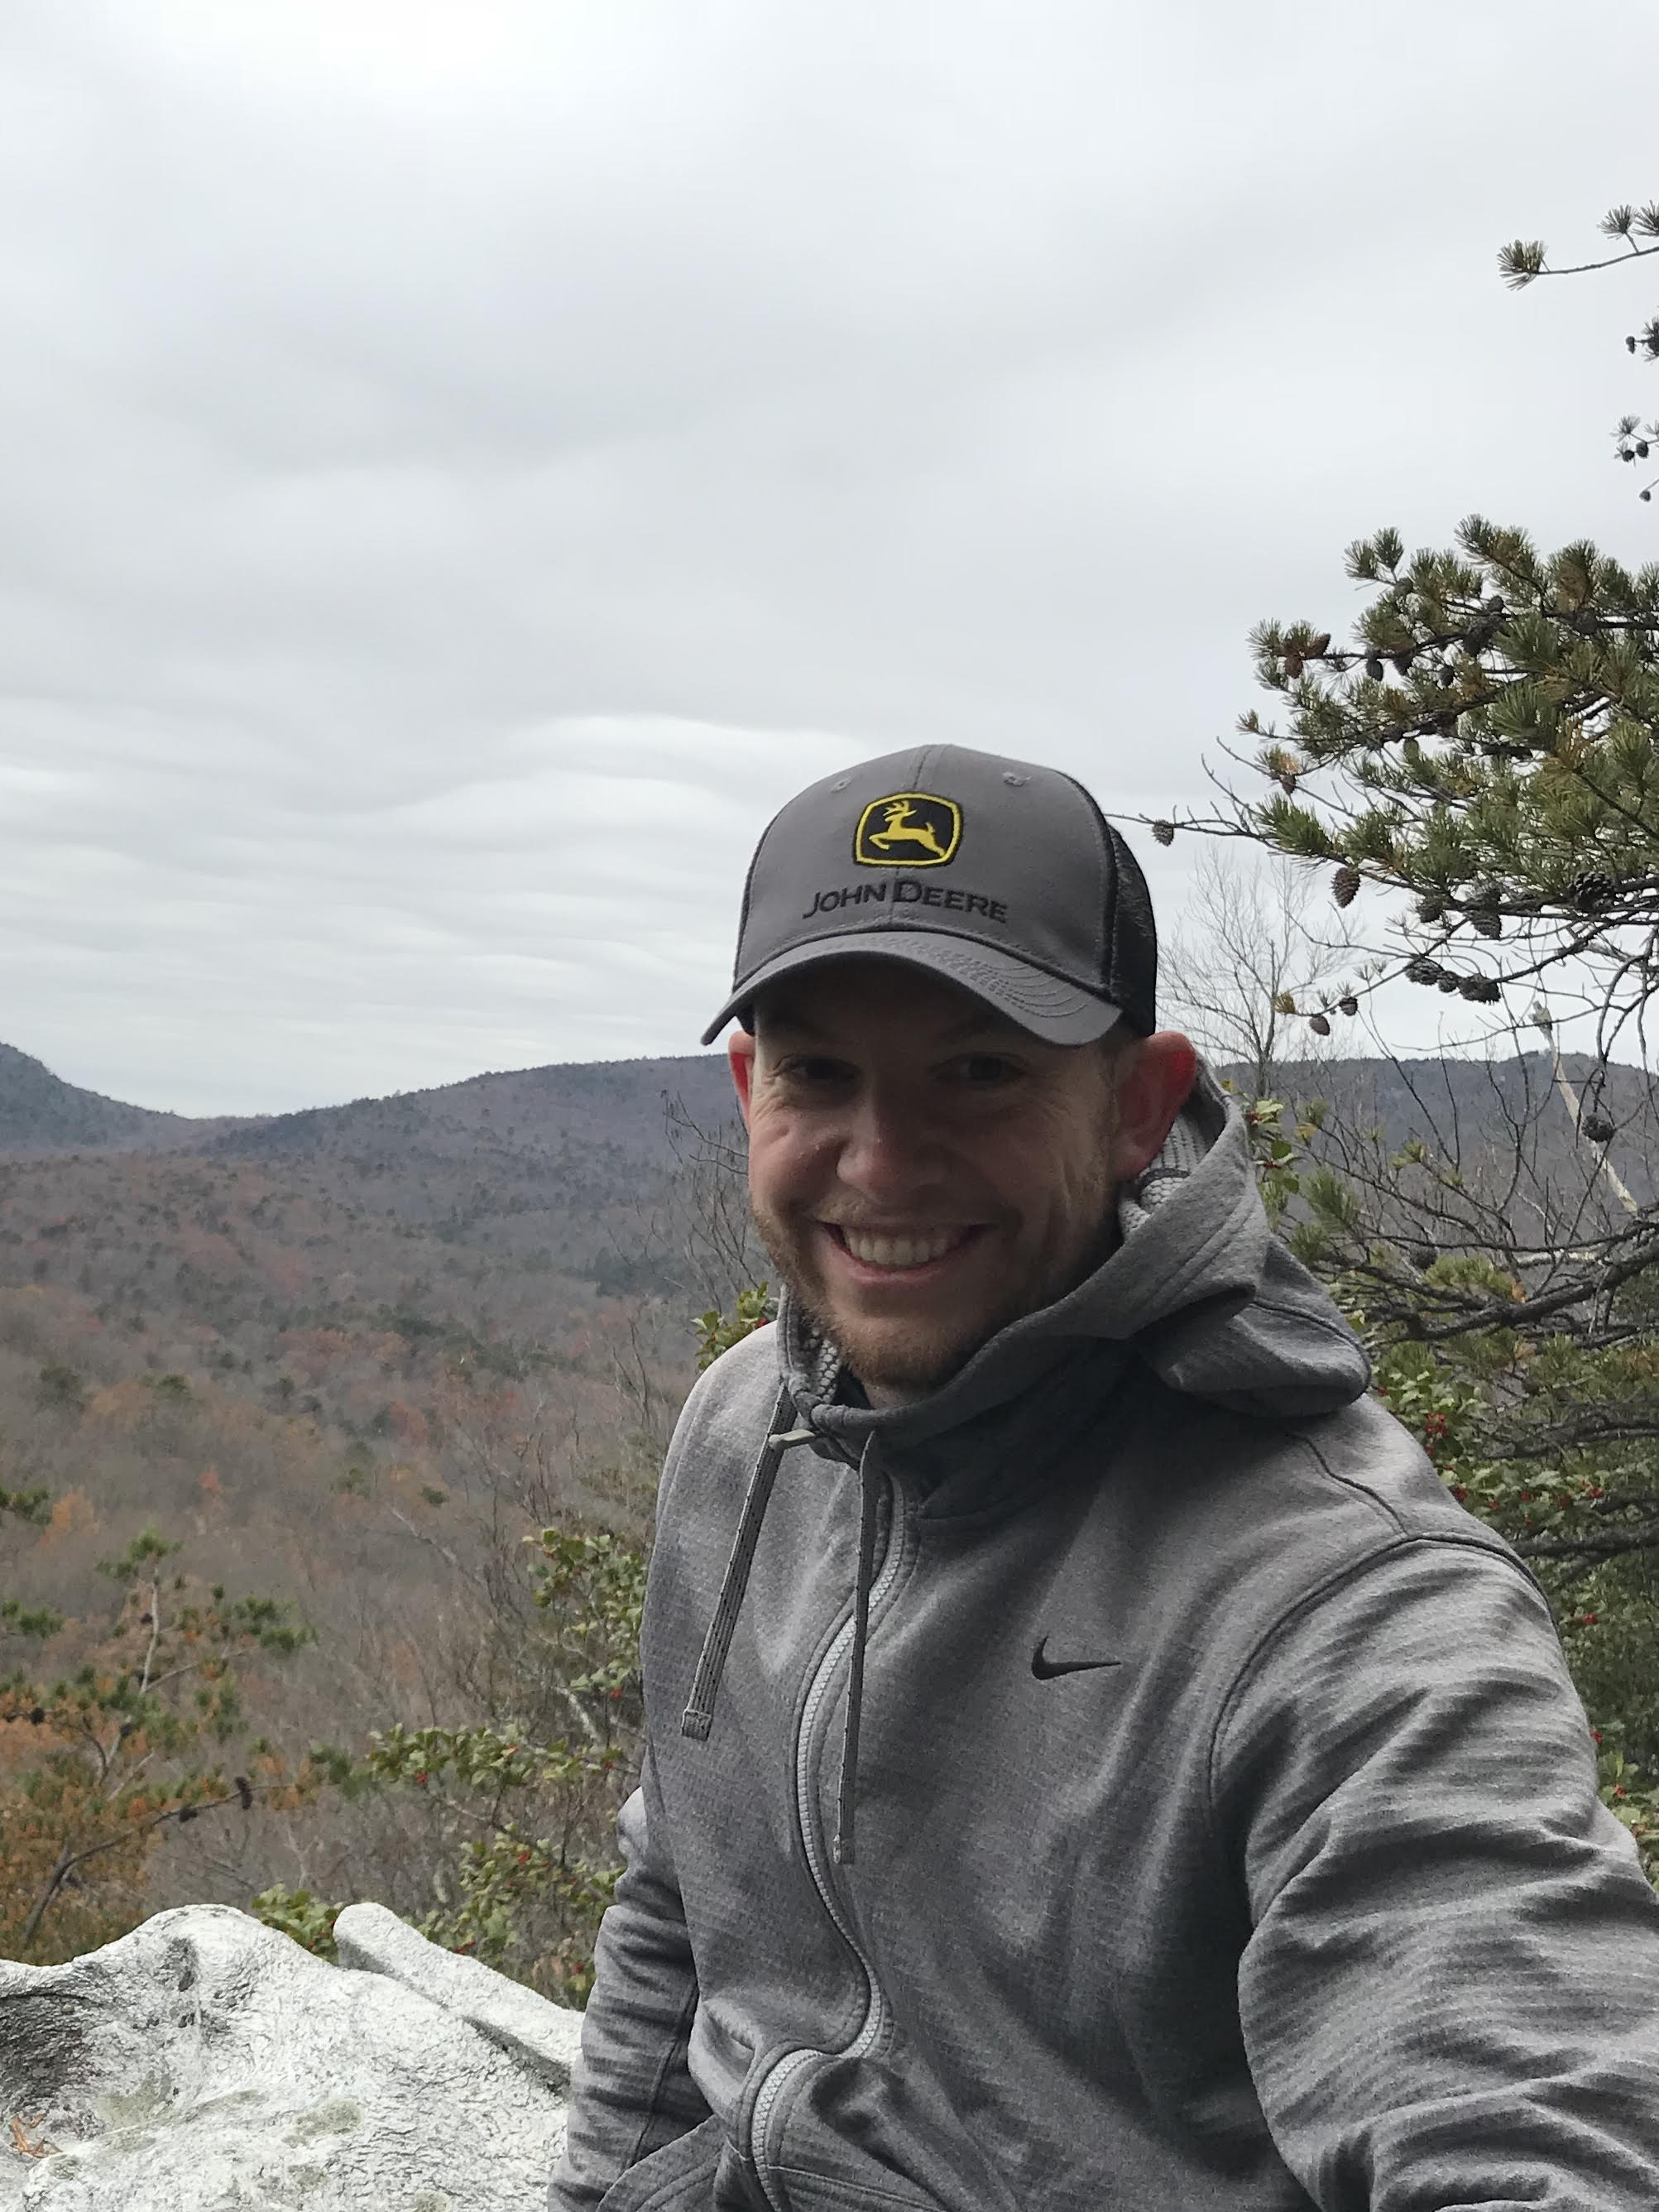
Contact Coach neuner:
Email-Michael.neuner@slps.org

Slide 8
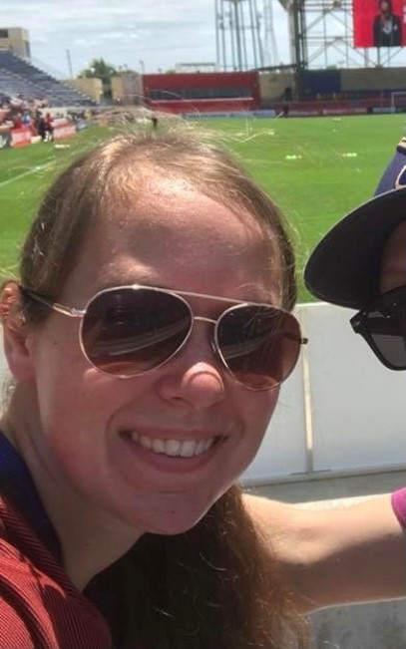
Meet coach Cather
This is my 4th year teaching PE and my 2nd year in Saint Louis Public Schools. I began my journey teaching in the Lindbergh School District and I spent last year as the PE teacher at Dunbar Elementary School.
I love doing anything and everything active. Some of my favorite ways to stay active are: hiking, biking, and playing basketball. I am also a HUGE fan of the St. Louis Blues.
I can’t wait to meet everyone this year!

Slide 9
PE with Coach neuner & Coach cather
We will be building the foundation for healthy habits
Creating a safe space to be active!
Being active 60 minutes per day not just the days we meet!
Discovering nutrition and mental health habits that help our students be the best they can be!

Slide 10
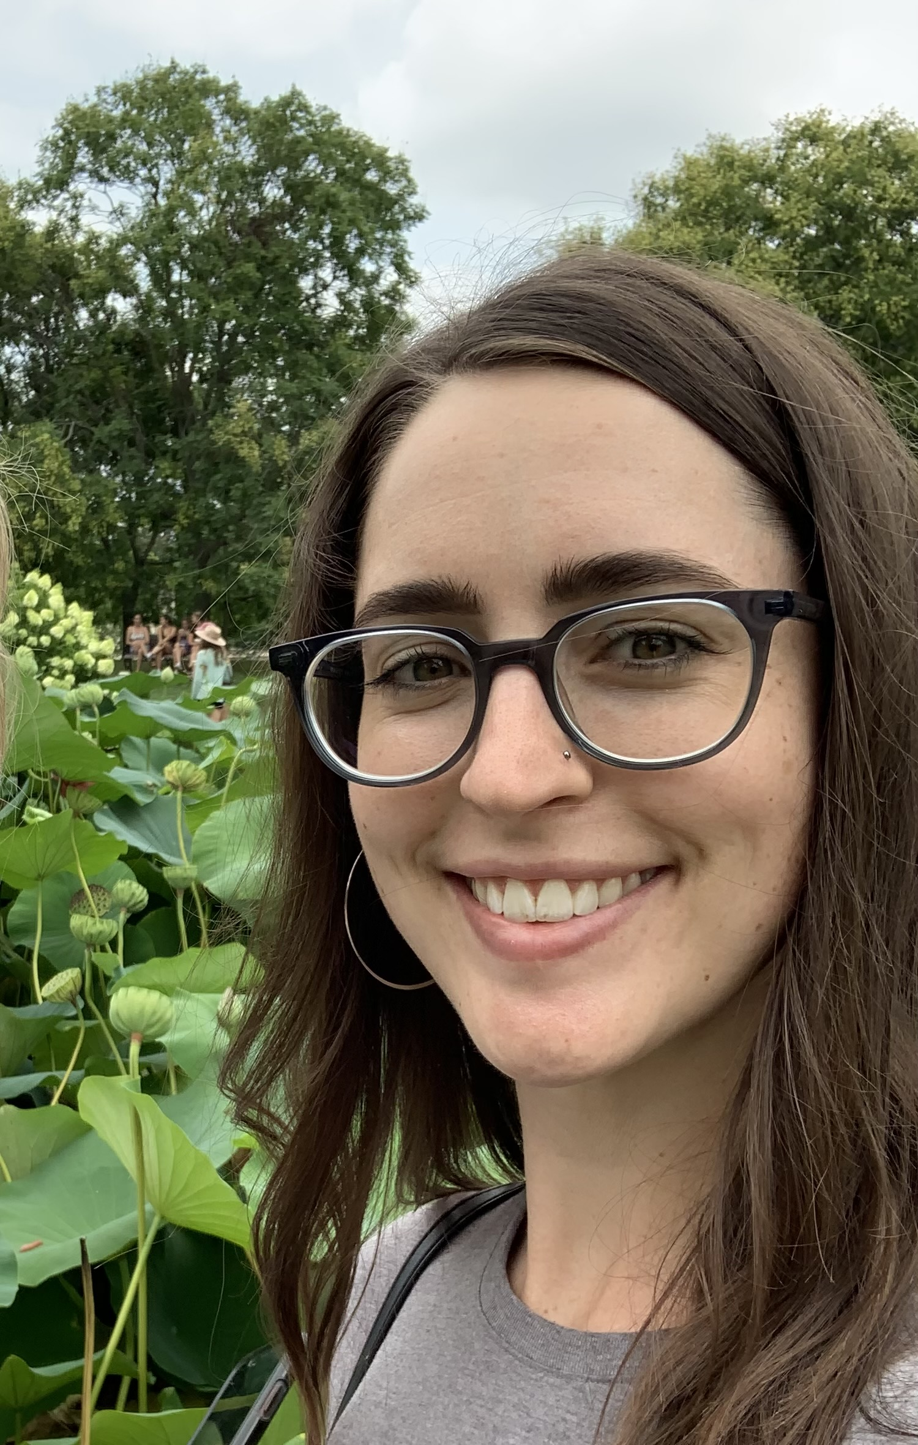
Music with Ms. V
Email: sarah.velasquez@slps.org
Website: slps.org/Domain/14014

Slide 11
Music learning goals
Students will learn music through
Creating
Responding
Connecting
Performing*
*No public performances through December

Slide 12
Thank you!
We cannot wait to see our students in class August 23rd!
Visual Art: karen.norman@slps.org
Music: sarah.velasquez@slps.org
PE: michael.neuner@slps.org
PE: mary.cather@slps.org

